Slide 1

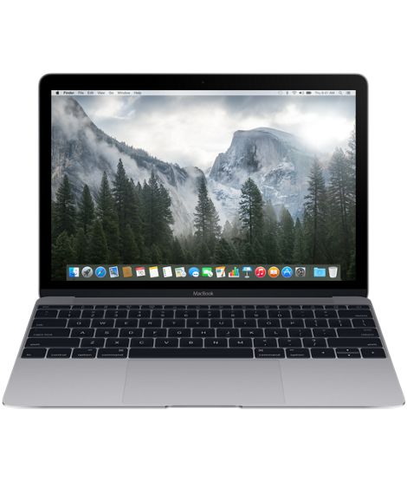

Improving the Security Posture of macOS and Linux with Azure AD

Slide 2


Intro
Michael Epping
Product Manager, Microsoft
michael.epping@microsoft.com
@_michaelepping
Mark Morowczynski
Product Manager, Microsoft
markmoro@microsoft.com
@markmorow

Slide 3
Agenda
What is Azure AD and Conditional Access?
Prompting…why is it bad?
Azure AD and Linux Servers
Azure AD and Macs
Azure AD and Linux Clients

Slide 4
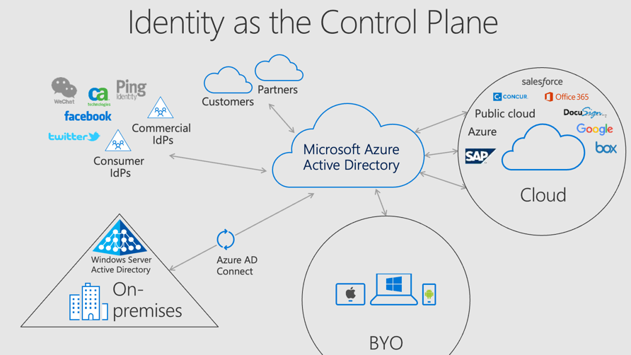
Azure AD
Azure AD is a full blown IDaaS solution, not an IDP for just Office 365/Azure
Resources are moving to the cloud, devices are proliferating, users are outside the office
Identity needs to be the new control plane, rather than the network perimeter

Slide 5
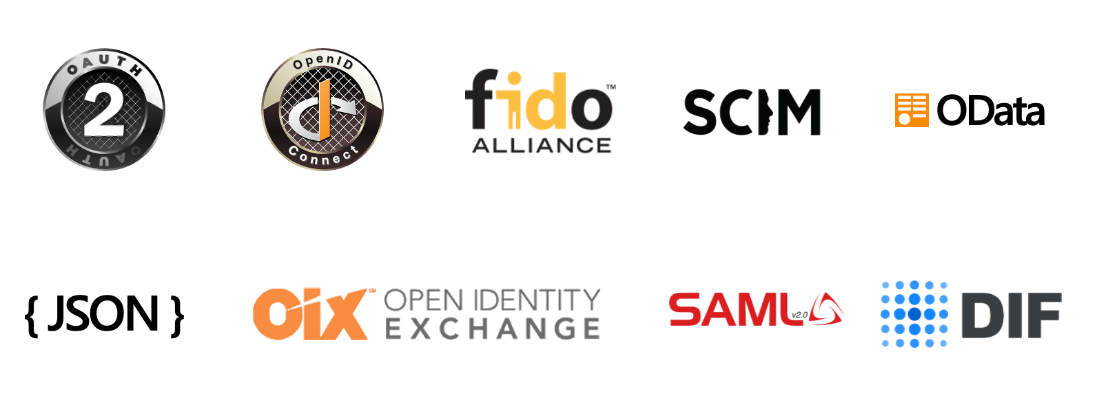
Azure AD Protocols
Committed to open standards, especially OpenID Connect and other modern protocols
Microsoft cloud services are built on OpenID Connect
Investing in new standards, like FIDO and DIF
See joint Passkeys announcement from FIDO foundation, Microsoft, Apple, and Google: https://aka.ms/PasskeyAnnouncement

Slide 6
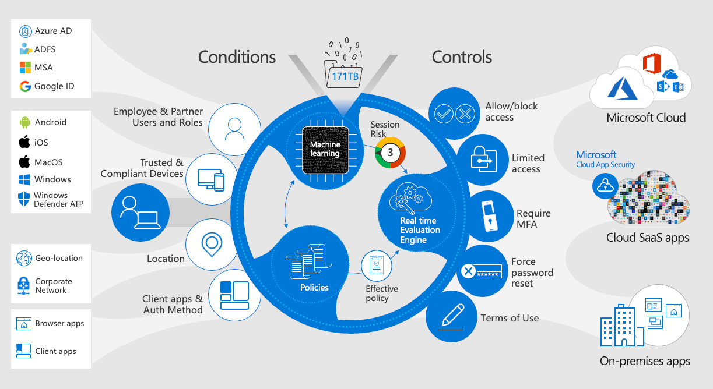
Conditional Access
Zero-trust AuthN and AuthZ engine
Evaluate trust every time a user or device requests access to a resource
Conditional access understands the user’s activity
User location
User Risk
State of device
Can we verify that Linux and Mac clients are in a good state?
App requirements
Resources might include Linux servers…

Slide 7
Conditional Access Evaluation Phase
{
"userDisplayName": "Michael Epping",
"appDisplayName": "Azure Portal",
"ipAddress": "97.113.39.216",
"clientAppUsed": "Browser",
"conditionalAccessStatus": "success",
"riskDetail": "none",
"riskLevelAggregated": "none",
"riskLevelDuringSignIn": "none",
"riskState": "none",
"resourceDisplayName": "Windows Azure Service Management API",
"deviceDetail": {
"deviceId": "",
"displayName": "",
"operatingSystem": "MacOs",
"browser": "Edge 102.0.1245",
"isCompliant": false,
"isManaged": false,
"trustType": ""
},
"location": {
"city": "Seattle",
"state": "Washington",
"countryOrRegion": "US",
"geoCoordinates": {
"altitude": null,
"latitude": 47.61837,
"longitude": -122.3142
}
}
}
All Conditional Access polices are ANDed together. (Not like GPO LSDO precedence)
Is Policy in scope of the request
BLOCK controls satisfied first
GRANT controls applied in order
Risk
MFA
Device
Approved client app/app protection
Tries to satisfy policy without user interaction
Example: Control MFA or Device compliant. If device is NOT compliant, will THEN prompt for MFA.
Notes:
Address confusion about CA policies

Slide 8
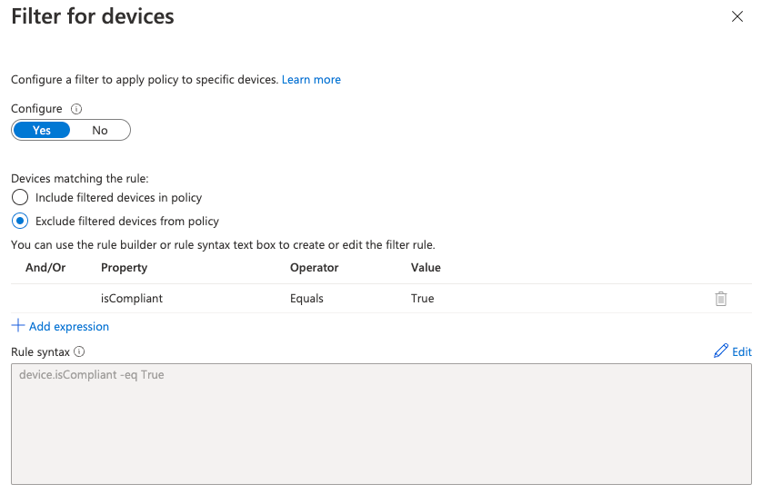
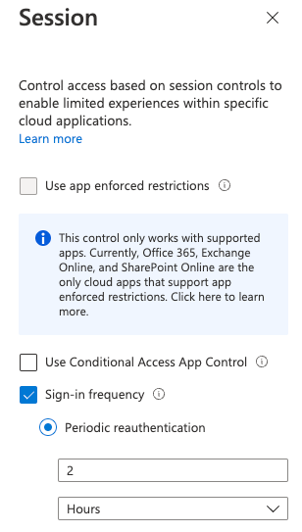
Common Policies
Talk to your IAM team to understand your Conditional Access policies
Requiring MFA for all users
Blocking legacy auth
Blocking access by country location
Require compliant or hybrid join device
Stricter Controls for non-corp managed devices
Sign-In Frequency to 2 hours for everything not filtered out
“Good” for security, but…
Notes:
Talk to your IAM team to understand your Conditional Access Policies!

Slide 9
Agenda
What is Azure AD and Conditional Access?
Prompting…why is it bad?
Azure AD and Linux Servers
Azure AD and Macs
Azure AD and Linux Clients

Slide 10
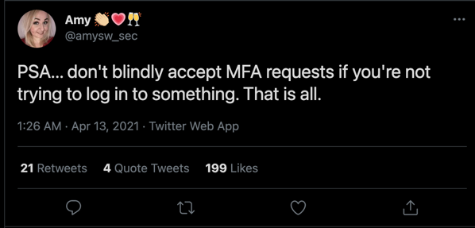
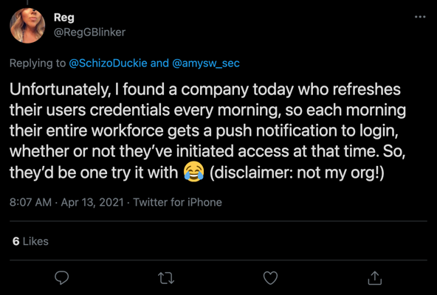
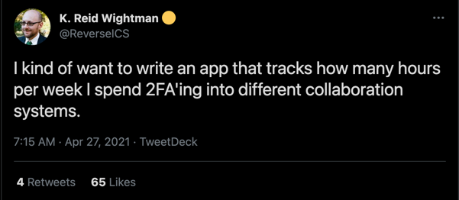

Slide 11
Customer Case Study
European financial company simulated cyber attack.
Attackers used password spray to find users with weak passwords.
Users with compromised passwords were “hammered” with MFA prompts.
Findings:
No reports of unexpected prompts to the help desk.
Many users blindly approved MFA requests.
One user had uninstalled the Authenticator app.

Slide 12
Why Prompting is Bad
Over-prompting leads to compromise
Users learn bad behaviors, like blindly approving MFA requests
Prompts impact productivity, especially on platforms without SSO
Prompting is especially common on macOS, which does not do SSO with Azure AD out of the box
Should strive to improve user experience AND security
Prompt when needed, such as new device, new location, change in risk, etc.
Passwordless makes prompting less impactful when it IS needed
This includes on macOS & Linux client/servers

Slide 13
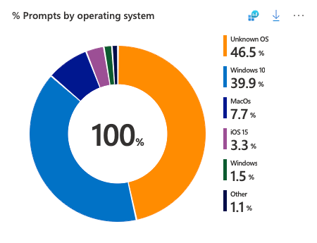
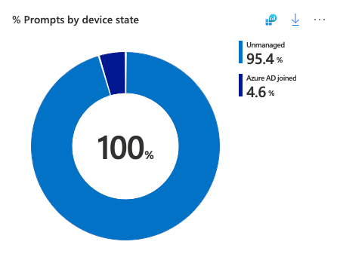
Determine if you have a prompting problem
Show it with data!
All the data you need is in your Azure AD sign-in logs
Use the pre-built Azure AD Workbook http://aka.ms/MFAPromptsWorkbook
Comes with data visualizations as well as recommendations:
Which users are being prompted the most?
Which applications have a high prompt count?
What is the device state?

Slide 14
Agenda
What is Azure AD and Conditional Access?
Prompting…why is it bad?
Azure AD and Linux Servers
Azure AD and Macs
Azure AD and Linux Clients

Slide 15
Conditional Access
Resources might include Linux servers…
Resources should definitely include Linux servers!
Azure AD and Conditional Access can provide AuthN and AuthZ for SSH access to Linux workloads running anywhere
Powerful security controls for determining which users on which devices can access which servers
Also works for workload identities!

Slide 16
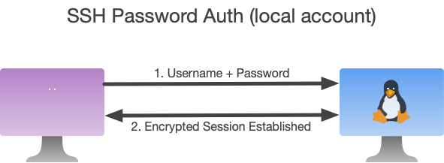
Why is AAD Login Important?
SSH can be authenticated in a few different ways:
Password (local, LDAP, RADIUS)

Slide 17
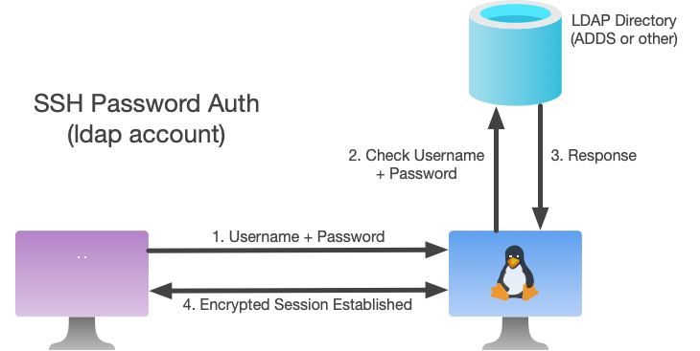
Why is AAD Login Important?
SSH can be authenticated in a few different ways:
Password (local, LDAP, RADIUS)
Kerberos

Slide 18
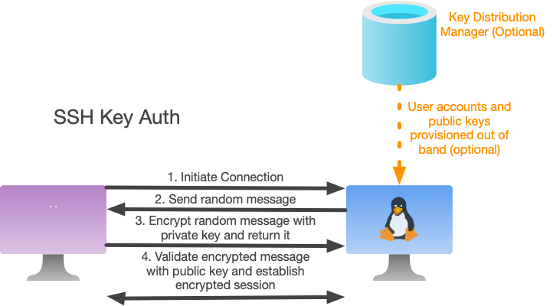
Why is AAD Login Important?
SSH can be authenticated in a few different ways:
Password (local, LDAP, RADIUS)
Kerberos
Public/Private Key Pairs
Private keys can optionally be protected with a passphrase or hardware, like a security key (this does not use WebAuthN / FIDO)
User Certificates from a PKI
Many organizations use the most common auth method: Public/Private Key Pairs

Slide 19
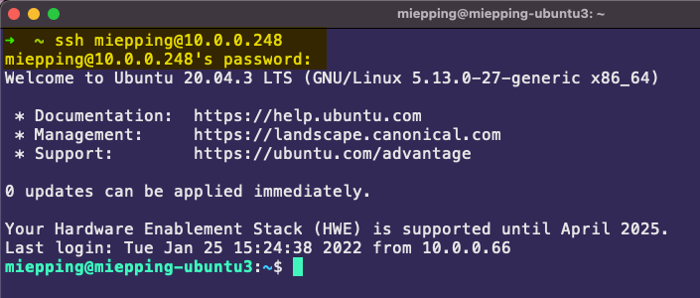
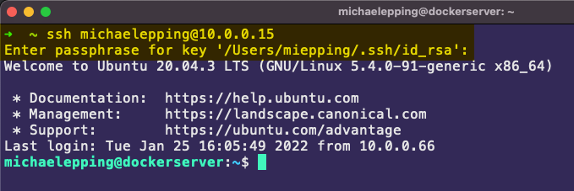
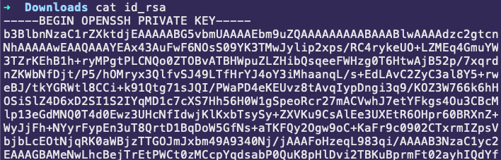
Why is AAD Login Important?
Password Auth:
Most Linux distros assume passwords or keys will be used out of the box
Immense investment in management and infrastructure required for LDAP, RADIUS, Key Distribution, or User Certificates
Key revocation is really hard, valid keys are often not revoked when a user leaves
Linux does not support WebAuthN and FIDO out of the box, there’s a lack of modern auth options
This leads to customers using passwords (weak) and keys (hard to manage)
There’s little to no device-based controls available, most protection is network-centric
Key Auth:

Slide 20





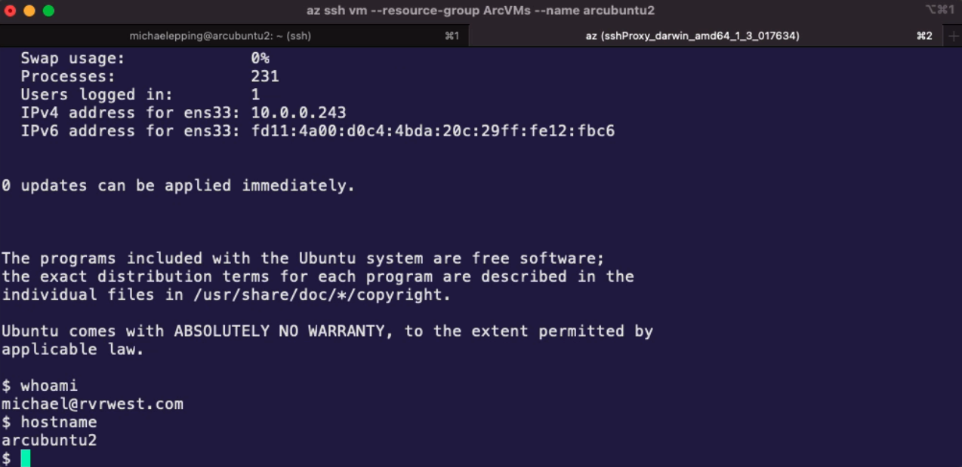




Azure AD & ARC · Login to Linux VMs
SSH via public Internet, Bastion, or VPN / ExpressRoute
Generally Available
VMs in Azure
Public Preview
Az CLI
Azure AD
Azure Arc
Privileged Identity Manager assigns eligible RBAC VM access roles
AuthN + AuthZ
OpenSSH
Certificate (instead of an access token)
Integration enables AuthN and AuthZ to Linux VMs hosted outside of Azure
VMs in AWS / GCP
Public Preview
Allow access
Require MFA
Block access
Conditional Access
On-Premises Servers

Slide 21
Azure AD Login via SSH for VMs in Azure – Client Prerequisites
Client device must have OpenSSH Client installed
(Recommended) Client device should have az cli installed, which comes with MSAL client components
az cli SSH extension must be installed
MANY types of clients are supported: Windows, macOS, Linux, Docker, Cloud Shell, etc. – doesn’t have to be Linux
Client must be able to reach the VM on the SSH port, 22 by default
Over internet (not recommended)
Site to Site VPN / ExpressRoute
Azure Bastion
Cloud Shell in Azure Portal

Slide 22
Azure AD Login via SSH for VMs in Azure – Server Prerequisites
Linux server running in Azure Commercial, Gov, or China
Linux server must be running a supported distro (see docs for up to date list)
CentOS, Debian, openSUSE, RedHat Enterprise Linux (RHEL), SUSE Linux Enterprise Server (SLES), Ubuntu Server
Linux server must have OpenSSH Server installed – standard in almost all distros
Linux server must be able to reach these endpoints (commercial):
https://packages.microsoft.com – used for installation and upgrades of VM components
http://169.254.169.254 – Azure Instance Metadata Service
https://login.microsoftonline.com - For AAD auth flows
https://pas.windows.net – For Azure RBAC flows
Linux server must have a System Assigned Managed Identity
Linux server must have the AADSSHLoginForLinux VM extension installed

Slide 23



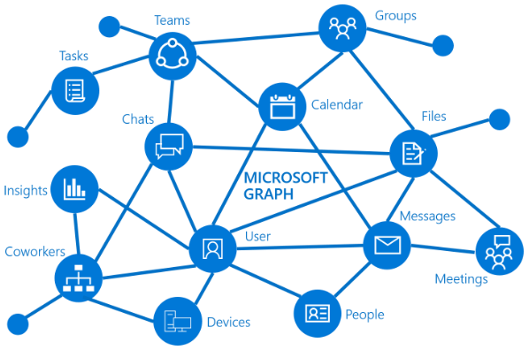
Azure AD Login via SSH for VMs in Azure
Client (Windows, macOS, Linux)
Client Components Installed
Azure AD and Conditional Access
Azure CLI w/ SSH Extension
MSAL
MS Graph
API
OpenSSH Client
SSH Cert Requested from MSAL (instead of access token)
Azure PAS Service
VM Extension Installed
Metadata Service
Color Coding
OpenSSH Server
SSH Extension:
PAM
Cert Handler
NSS
Microsoft Component Built for AAD Login Feature
Standard OS Component
Linux VM
Azure VM Host
Azure Management Services

Slide 24
Azure AD Login via SSH for VMs in Azure
PIM integration supported for Azure RBAC roles
Admin (sudo) role: Virtual Machine Administrator Login
Non-Admin role: Virtual Machine User Login
Client (Windows, macOS, Linux)
Azure AD and Conditional Access
Azure CLI w/ SSH Extension
MSAL
MS Graph
API
OpenSSH Client
“Ephemeral” SSH Cert Returned (basically a 1 hour access token)
Azure PAS Service
RBAC Role Checked
SSH Cert Validated
Metadata Service
Color Coding
SSH Cert Sent, Waiting for Tunnel
OpenSSH Server
SSH Extension:
PAM
Cert Handler
NSS
Microsoft Component Built for AAD Login Feature
Standard OS Component
Linux VM
Azure VM Host
Azure Management Services

Slide 25
Azure AD Login via SSH for VMs in Azure
Client (Windows, macOS, Linux)
Azure AD and Conditional Access
Azure CLI w/ SSH Extension
MSAL
MS Graph
API
OpenSSH Client
Azure PAS Service
SSH Tunnel Established, user signed in with AAD account
Metadata Service
Color Coding
OpenSSH Server
SSH Extension:
PAM
Cert Handler
NSS
Microsoft Component Built for AAD Login Feature
Standard OS Component
Linux VM
Azure VM Host
Azure Management Services

Slide 26
Azure AD Login via SSH for VMs Outside Azure - Prerequisites
Linux server must be onboarded to Azure Arc and have the Azure Arc agent running and connected to Azure (see Arc documentation)
Linux server must be running a distro supported for AAD SSH login
Linux server must have OpenSSH Server installed – standard in almost all distros
Linux server must be able to reach Azure endpoints (see Arc documentation)
Linux server must have a System Assigned Managed Identity
Linux server must have the aadsshlogin package installed
Linux server must have Arc configured to allow inbound connections on the desired SSH port (22 by default)
This is Arc-specific, different than configuring the firewall
Notes:
Azure Arc machine agent onboarding docs: https://docs.microsoft.com/en-us/azure/azure-arc/servers/agent-overview
Simple one-off script onboarding doc: https://docs.microsoft.com/en-us/azure/azure-arc/servers/onboard-portal

Slide 27

Azure AD Login via SSH for VMs outside Azure
Client (Windows, macOS, Linux)
Client Components Installed
SSH Cert Requested from MSAL (instead of access token)
MS Graph
API
Azure AD and Conditional Access
Azure CLI w/ SSH Extension
MSAL
Azure PAS Service
Azure Arc Service
OpenSSH Client
Linux VM Connected to Azure Arc Service
VM Extension Installed
Color Coding
OpenSSH Server
SSH Extension:
PAM
Cert Handler
NSS
On-Prem / AWS / GCP / Other Datacenter
Microsoft Component Built for AAD Login Feature
Azure Arc Agent
Standard OS Component
Azure Management Services
Linux Server
Azure Arc Agent Installed on VM

Slide 28

Azure AD Login via SSH for VMs outside Azure
PIM integration supported for Azure RBAC roles
Admin (sudo) role: Virtual Machine Administrator Login
Non-Admin role: Virtual Machine User Login
Client (Windows, macOS, Linux)
“Ephemeral” SSH Cert Returned (basically a 1 hour access token)
MS Graph
API
Azure AD and Conditional Access
Azure CLI w/ SSH Extension
MSAL
Azure PAS Service
Azure Arc Service
OpenSSH Client
SSH Cert Sent, Waiting for Tunnel
SSH Cert Validated
RBAC Role Checked
Color Coding
OpenSSH Server
SSH Extension:
PAM
Cert Handler
NSS
On-Prem / AWS / GCP / Other Datacenter
Microsoft Component Built for AAD Login Feature
Azure Arc Agent
Standard OS Component
Azure Management Services
Linux Server

Slide 29
Azure AD Login via SSH for VMs outside Azure
Client (Windows, macOS, Linux)
MS Graph
API
Azure AD and Conditional Access
Azure CLI w/ SSH Extension
MSAL
SSH Tunnel Established, user signed in with AAD account
Azure PAS Service
Azure Arc Service
OpenSSH Client
Color Coding
OpenSSH Server
SSH Extension:
PAM
Cert Handler
NSS
On-Prem / AWS / GCP / Other Datacenter
Microsoft Component Built for AAD Login Feature
Azure Arc Agent
Standard OS Component
Azure Management Services
Linux Server

Slide 30
Azure AD Login via SSH – Connection Process
Connect to Azure Resource Manager
Conditional Access policies that apply to the “Azure Management” cloud app apply at this stage
az login
Specify which Azure subscription you are working in
az account set --subscription <subscription_name_or_id>

Slide 31
Azure AD Login via SSH – Connection Process
Connect to your VM of choice
Conditional Access policies that apply to the “Azure Linux VM Sign-In” cloud app apply at this stage
Some or all of the Conditional Access grant controls may already have been satisfied when running az login
If any Conditional Access criteria were not already met the browser will be re-opened
Connect through the Azure Arc SSH relay (no line of sight to VM required):
az ssh vm --vm-name <vm_name> -g <resource_group_name>
Connect to the VM directly (line of sight to VM required):
az ssh vm --ip 10.0.x.x

Slide 32
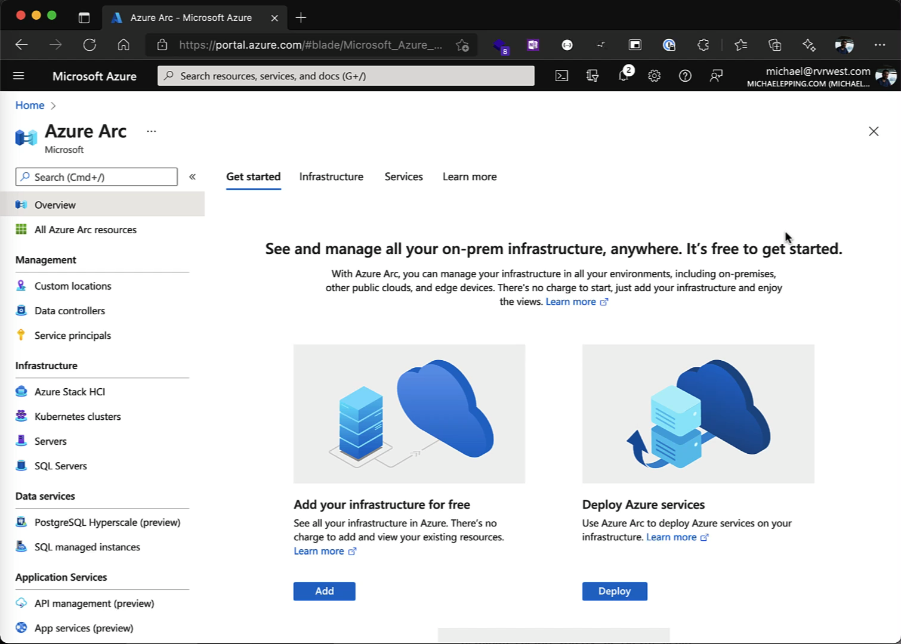
Arc VM SSH Demo

Slide 33
Agenda
What is Azure AD and Conditional Access?
Prompting…why is it bad?
Azure AD and Linux Servers
Azure AD and Macs
Azure AD and Linux Clients

Slide 34
Quick aside on client devices
Two critical capabilities for any client OS:
Device health attestation
Windows has two options:
MDM compliance
Hybrid Azure AD Join – tells Azure AD the device is managed by on-premises AD, this is not as good as device compliance!
Everything else has only one option:
MDM compliance
No other good way to tell if a device is in a good state
Getting devices MDM-managed and healthy is critical to good Zero Trust policies
Single Sign-On (SSO)
Prompting users too much is bad!
User experience and security go hand in hand

Slide 35
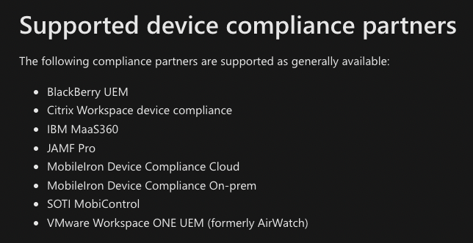
Enroll Macs in MDM, Use Device Compliance
MDM is the only modern way to deploy SSO features to macOS
MDM helps us improve device and identity security (Conditional Access)
SSO helps us improve end-user experience (fewer prompts) and security (over-prompting trains users to make poor decisions)
These are related, but different features
Intune or Intune-integrated MDMs can send compliance information to Azure AD
This information is critical for those device-based Conditional Access policies
Without Intune or an Intune-integrated MDM, Azure AD sees all Macs as unmanaged

Slide 36
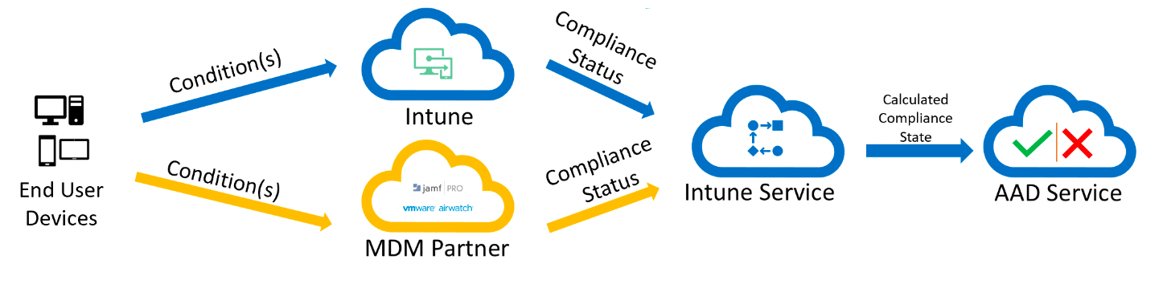
Device Compliance with Azure AD
Device health and compliance integration with Azure AD is easy to deploy if Intune is the MDM
Jamf Pro and other 3rd Party MDMs can integrate with Intune to support device compliance
Extra work, but worth it

Slide 37
Set up SSO Infrastructure
macOS can provide SSO in a few different ways:
Kerberos, via BIND to an LDAP directory, commonly on-premises Active Directory
Apple is actively telling customers to move away from this
Kerberos, via Apple’s Kerberos SSO Extension
Must be deployed through MDM
Still designed for on-premises directory services, not really designed for the cloud
Modern Auth (tokens), via IDP vendor-provided plug-ins for Apple’s Extensible Enterprise SSO Framework
IDP vendor…that’s us!
Must be deployed through MDM
Two types:
Credential
Redirect – Azure AD’s option is this type

Slide 38



SSO - Let’s Start with Kerberos
If you need Kerberos, use the modern, MDM-provisioned Kerberos SSO Extension from Apple:
User provides device with their enterprise username and password
The device sends the creds to AD and asks for a Kerberos Ticket-Granting Ticket (TGT)
AD validates the creds and returns the TGT
The user tries to access an app, probably in their browser, but needs a Kerberos ticket
Kerberos
App
U: jane.doe@contoso.com
P: Summer2022!
Active Directory
Notes:
In step 1, the credentials can be provided on the lock screen if synced to AD, or the user can log in with unrelated local creds and provide enterprise creds once they are logged in

Slide 39


SSO - Let’s Start with Kerberos
macOS sends the TGT to AD, asking for a ticket specific to the app (TGS)
AD validates the TGT and returns the TGS
The user’s browser or other client sends the TGS to the app
The user successfully accesses the app
Kerberos
App
Active Directory

Slide 40
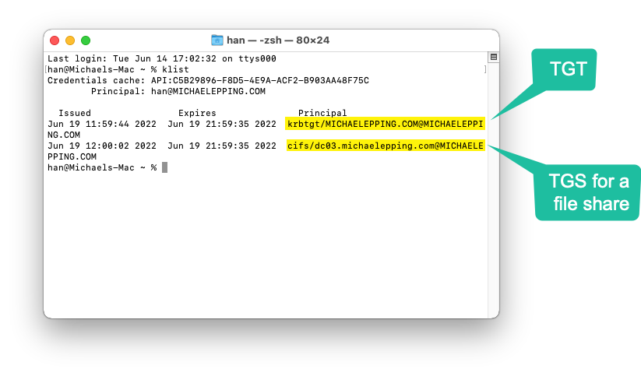
SSO - Let’s Start with Kerberos

Slide 41

Limitations with Kerberos
What’s the issues with this story?
It doesn’t work over the internet, so it isn’t very modern
Imagine we have a SaaS app instead of an internal Kerberos app
Kerberos doesn’t make sense for the SaaS app, because devices on the internet shouldn’t be able to find a DC
User provides device with their enterprise username and password
Should the device still want to send the creds to AD and ask for a Kerberos Ticket-Granting Ticket (TGT)?
No, this won’t work without a VPN
Kerberos
App
U: jane.doe@contoso.com
P: Summer2022!
Active Directory
SaaS
App

Slide 42
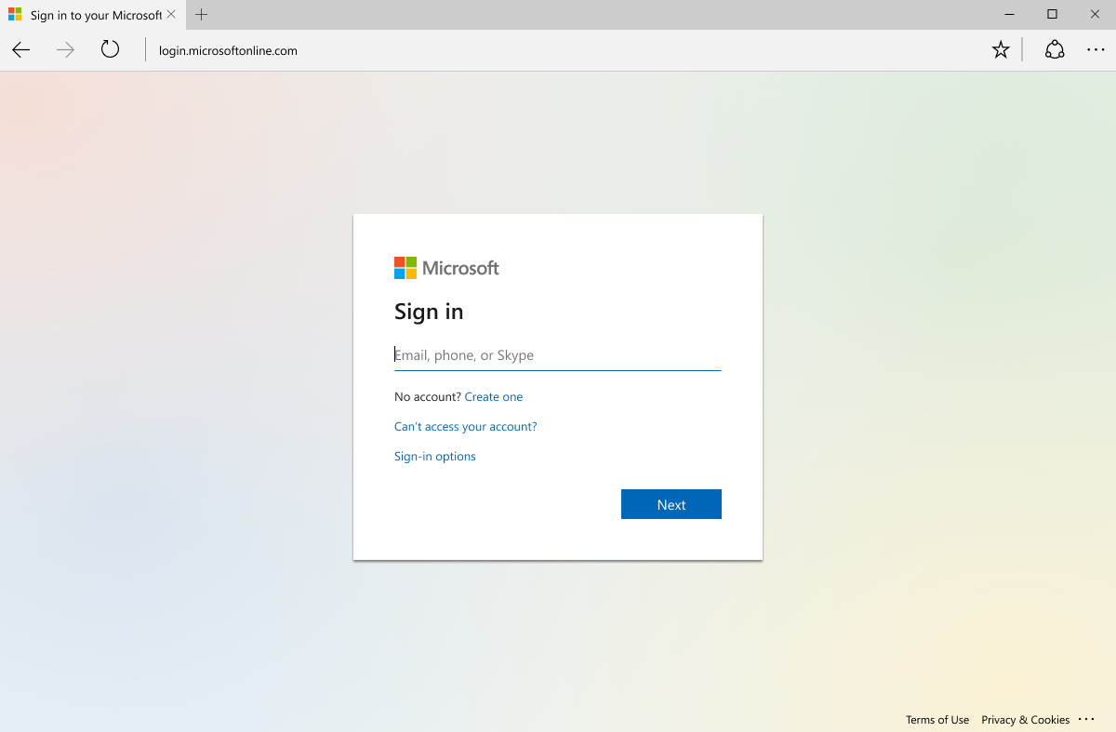
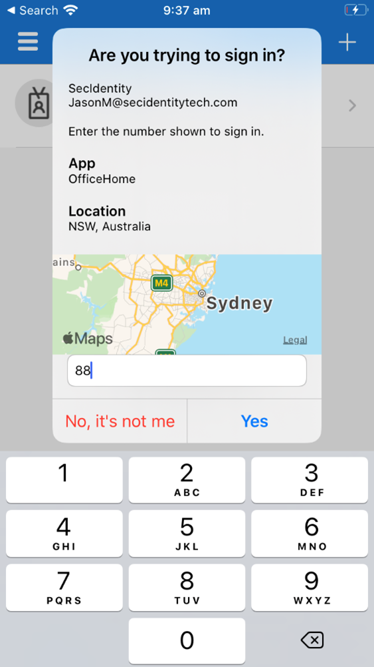
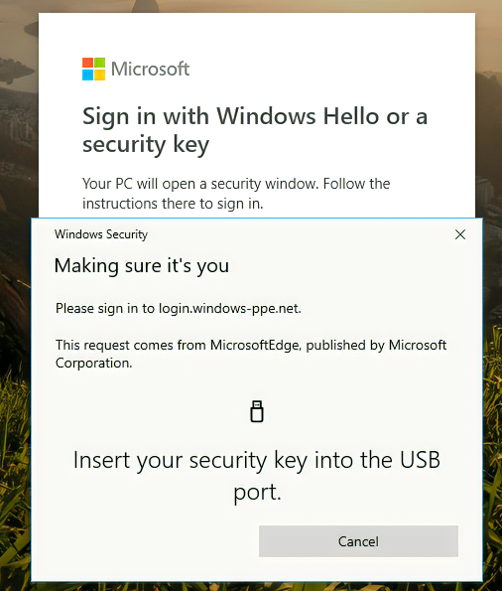
SSO – Modernize w/ Modern Auth
The solution is Modern Auth!
SAML – good
OpenID Connect and OAuth 2 - better!
The key advantage of Modern Auth is that it is web-based
The flexibility of web technology gives us many security options:
Challenge for certificates
Many forms of MFA (FIDO, Auth apps, Smartcards, SMS codes, etc.)
Direct traffic through proxied sessions to block downloads
And much more!

Slide 43

SSO – Modernize w/ Modern Auth
Per User/Device
Per Application
Our Goal: Prompt Once
per user
per device
per password change
Don’t bother user unless these change
Browser apps
Client apps
Web/App
Authentication
(Coarse) Authorization
Until Revoked or Password Change (If actively used within 14 days)
Until revoked or Password Changed
Refresh Token – (Per App)
Long term access to an application
Note: Includes whether MFA was used for authentication
Primary Refresh Token
Long term authentication w/ SSO broker on Windows, macOS, or iOS
ID Token
Long term authentication on Mobile Device (used by authenticator app and/or company portal) Note: Authenticator App has two functions: brokering authentication locally + MFA validation
1 hours
Access Token – (Per App)
Provides user access to use application (short term) Note: Policy is re-evaluated every time you get a new access token (using the refresh token)
https://aka.ms/BTVModernAuth

Slide 44
Modern Auth SSO Extension Requirements
Here’s what you need for Modern Auth and SSO on Apple Platforms:
IDP that supports SAML and/or OpenID Connect
Azure AD is Microsoft’s cloud IDP, but there are plenty of others on the market
Apps integrated with the IDP
IDP Vendor must create an SSO Extension plugin
Macs under MDM management

Slide 45






SSO – Modernize w/ IDP Vendor SSO Extensions
App
The modern approach is to use an IDP, modern auth, and tokens
SSO Extension is bundled in the Microsoft Company Portal
User authenticates to Azure AD in the SSO Extension window – this can be in Company Portal or another app, such as Safari
Azure AD supports many more credential types than AD does
Azure AD SSO Extension acquires a Primary Refresh Token (PRT) from Azure AD after the user signs in, stores it in the keychain
PRTs are good for a rolling 14 day window, constantly refreshed when the user uses the Mac
MS Authenticator Passwordless
Phone Sign-In
Username+Pwd+MFA (App, OTP, SMS, Phone)
Azure AD
Notes:
Platform SSO capability will allow us to validate enterprise creds at the lock screen instead of after the user signs in. This is a future capability

Slide 46


SSO – Modernize w/ IDP Vendor SSO Extensions
App
One more wrinkle…there’s two different flows for apps to get tokens
We’ll start with the MSAL flow (MSAL is Microsoft Authentication Library, our auth library provided to make app integration with Azure AD easy):
App that uses MSAL talks to the SSO Extension directly, asks it to get a token
AAD validates the PRT and returns the app-specific token
The token is given to the client and the client sends the token to the app
The user successfully accesses the app
Azure AD

Slide 47
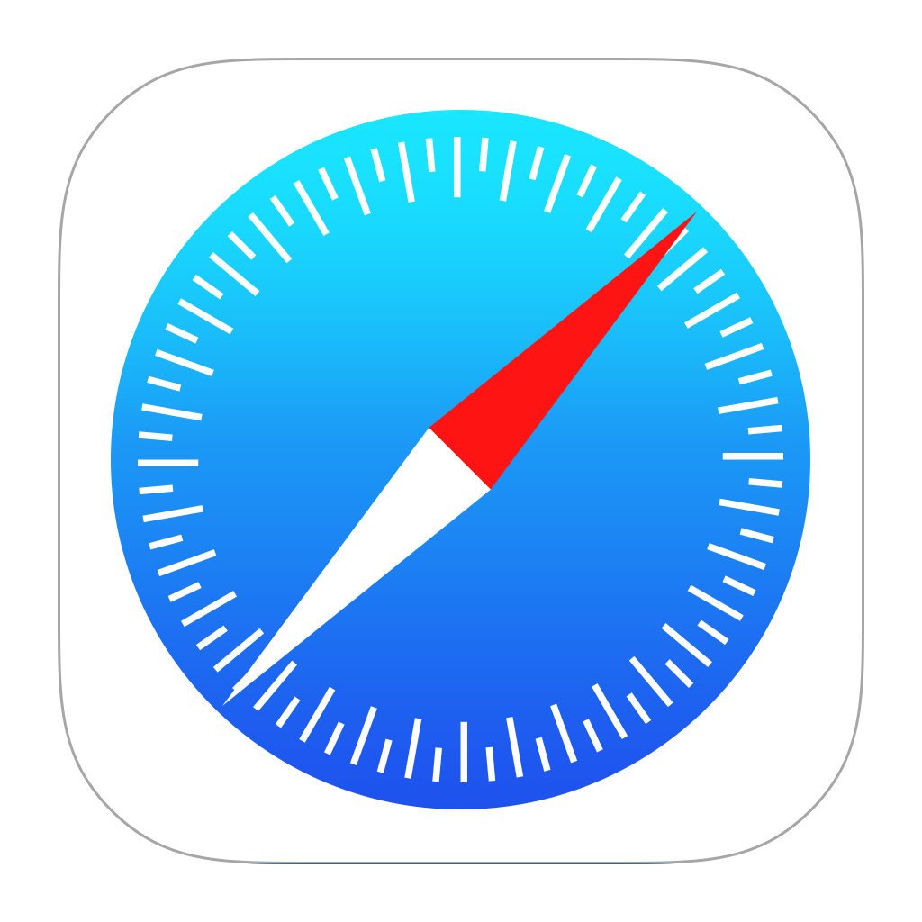
SSO – Modernize w/ IDP Vendor SSO Extensions
App
Now let’s look at the redirect flow:
User tries to log into app, is told to get a token from Azure AD
App that doesn’t use MSAL tries to go to an Azure AD URL…the macOS Network Stack intercepts the traffic and redirects it to the SSO Extension
SSO Extension uses its PRT to request a token
AAD validates the PRT and returns the app-specific token
The token is given to the client and the client sends the token to the app
The user successfully accesses the app
macOS Network Stack
Azure AD

Slide 48
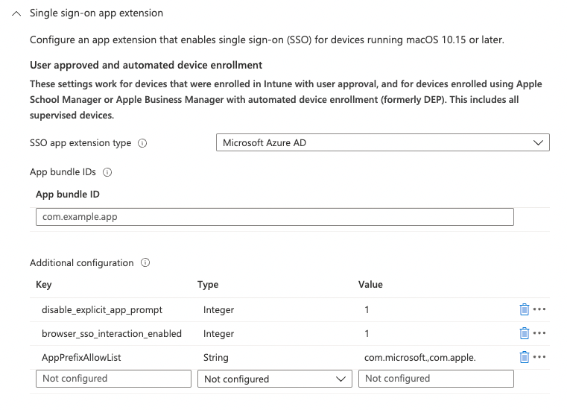
SSO – Modernize w/ IDP Vendor SSO Extensions
Redirect SSO Extension Profiles must be deployed via MDM:
Very easy deployment with Intune as your MDM
https://aka.ms/AppleSSO-Intune
Notes:
MDM requirement comes from Apple. Security implications from being able to intercept network traffic

Slide 49
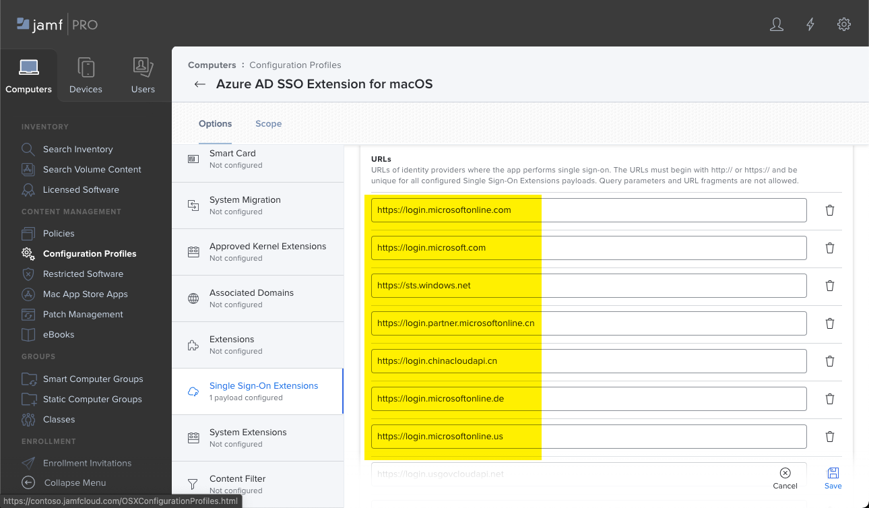
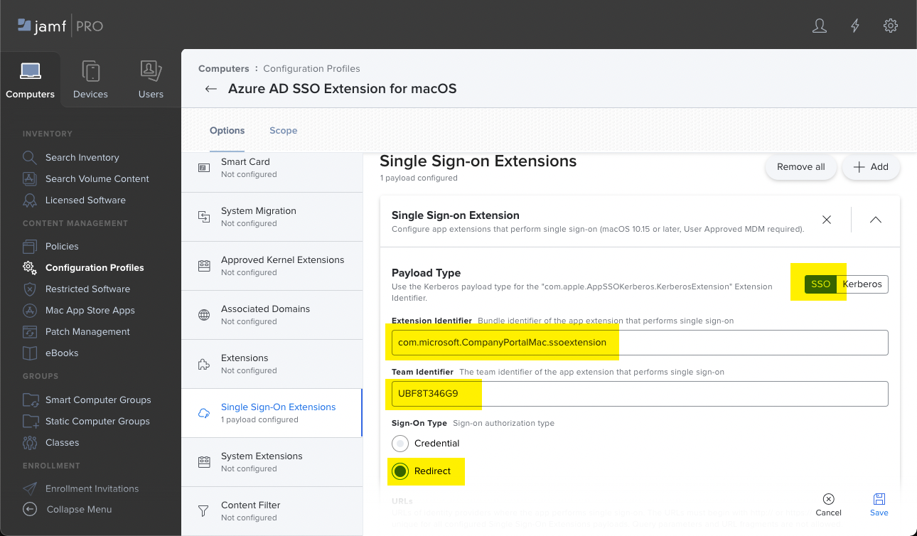
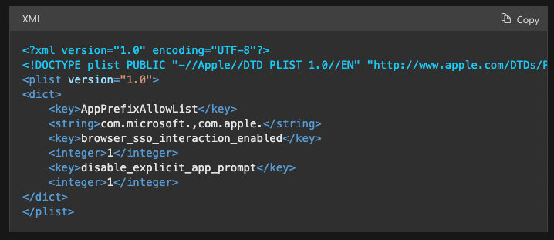
SSO – Modernize w/ IDP Vendor SSO Extensions
Redirect SSO Extension Profiles must be deployed via MDM:
Very easy deployment with Intune as your MDM
Jamf Pro requires a little more work and a PLIST file
https://aka.ms/AppleSSO-JamfPro
Notes:
Consider adding com.jamf. to the AppPrefixAllowList if you use Jamf Pro

Slide 50
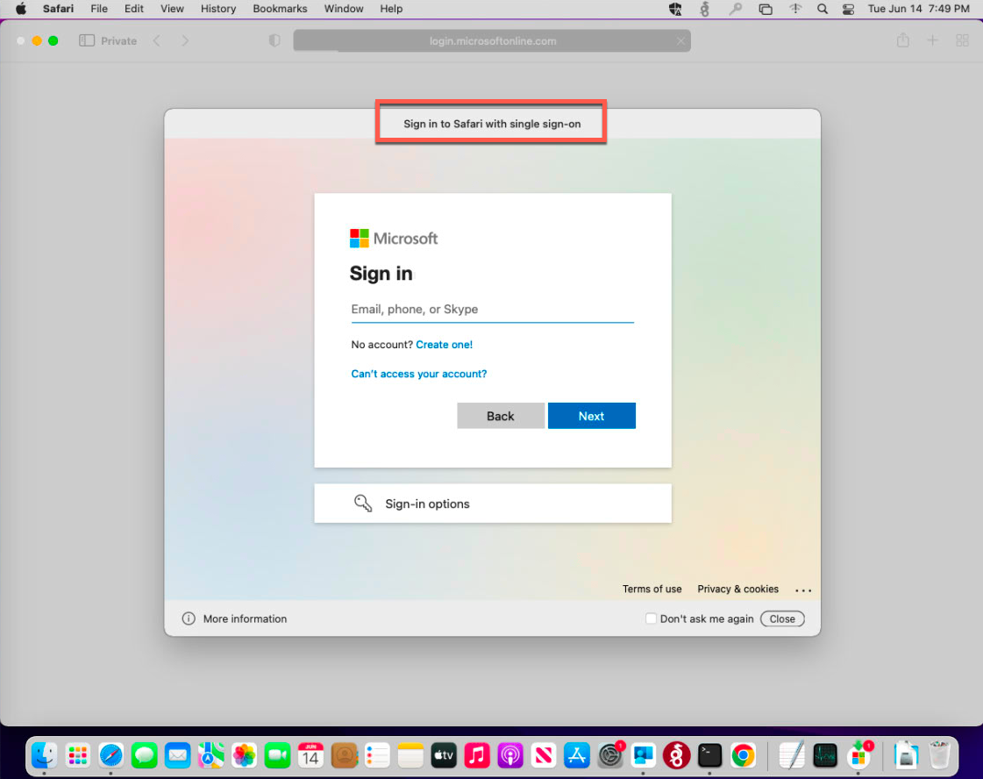
SSO – Modernize w/ IDP Vendor SSO Extensions
Redirect SSO Extension Profiles must be deployed via MDM:
Very easy deployment with Intune as your MDM
Jamf Pro requires a little more work and a PLIST file
Can configure settings so users never need to open Company Portal
Company Portal must always be installed, but users don’t need to open it if you follow recommended config
Don’t need to integrate with Intune for CA in order to get SSO, its just recommended
Easiest tool to test if things are working is Safari in Private mode
Notes:
Consider adding com.jamf. to the AppPrefixAllowList if you use Jamf Pro

Slide 51
Modern Auth SSO Extension Caveats
There’s a few limitations/caveats/warnings:
SSO Extension component from Microsoft is still Public Preview (supported)
Apps must use MSAL or Apple’s system frameworks for network requests
This means that some apps don’t work…the SSO Extension is unaware of them and they don’t use Apple’s network stack
Chrome and Firefox are the primary examples
Talk to your app vendors about the need to support SSO extensions! They should want their apps to work, Apple is only making SSO extensions more important as time goes on

Slide 52
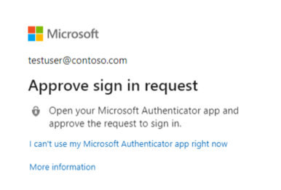
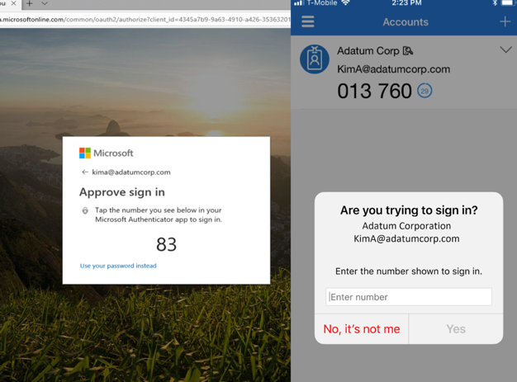
Move To The Authenticator App and Passwordless
Authenticator App used as a token broker for iOS devices (similar to Company Portal on MacOS)
Provides that PRT experience
https://aka.ms/nudge will interrupt on sign-in to register for Authenticator App
Move from push notification to number match if possible (MFA hammering)
Also used as a passwordless method

Slide 53
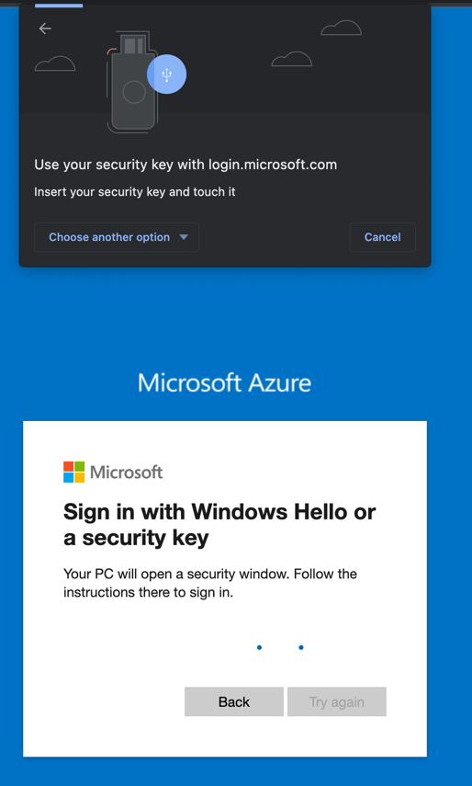
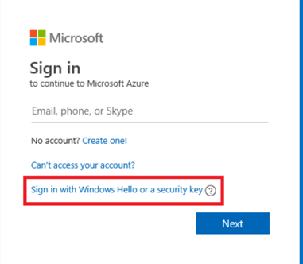
Move To The Authenticator App and Passwordless
Best user experience + Best security
We’ve been passwordless since Nov 2020 on macOS!
Can be used with any app integrated in your Azure AD
Passwordless methods
Authenticator app number match
FIDO2 Key
Private key never leaves the physical key
Edge and Chrome today
Safari in the future
Passkeys
Emerging standard supported by Apple, Microsoft and Google!
Passkey synced across devices on same device platform

Slide 54
Agenda
What is Azure AD and Conditional Access?
Prompting…why is it bad?
Azure AD and Linux Servers
Azure AD and Macs
Azure AD and Linux Clients

Slide 55
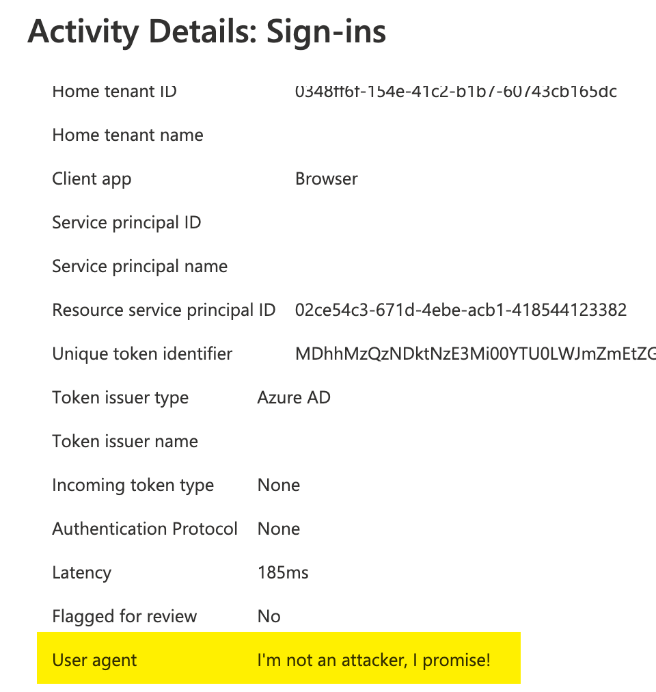
Linux as a device platform in Conditional Access
Azure AD identifies the platform by using information provided by the device
Intune-managed devices can have their OS detected pretty accurately
In other cases, user agent strings will be used to identify the OS
Since user agent strings can be modified, this information is unverified

Slide 56
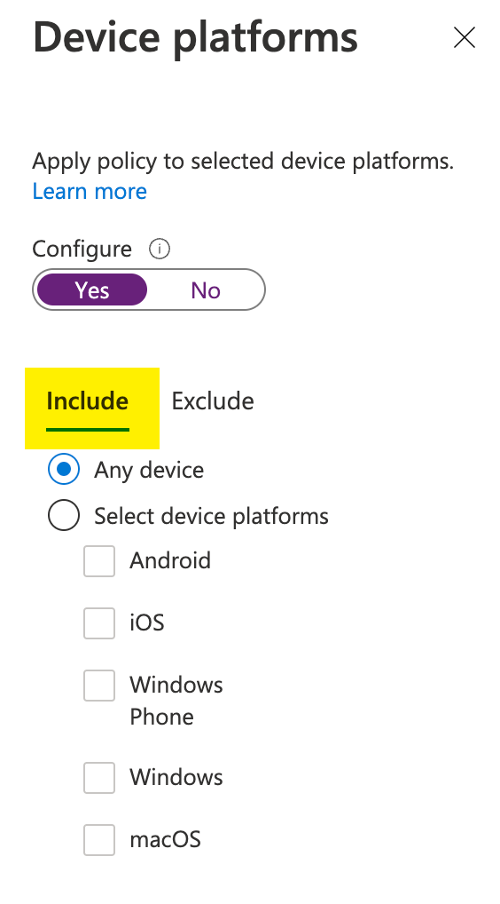
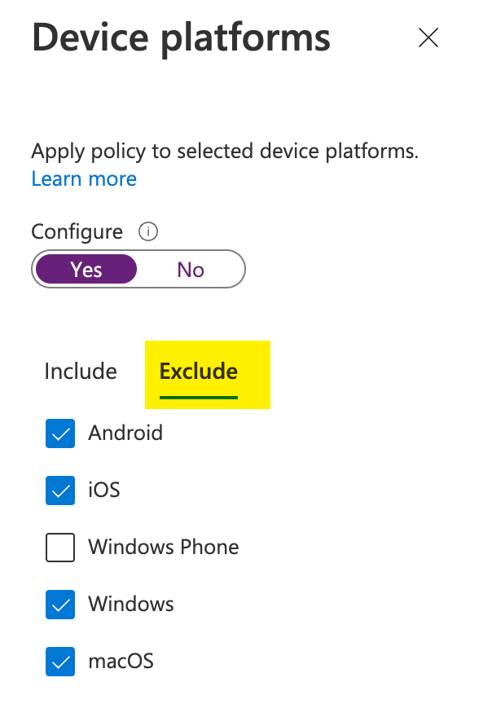
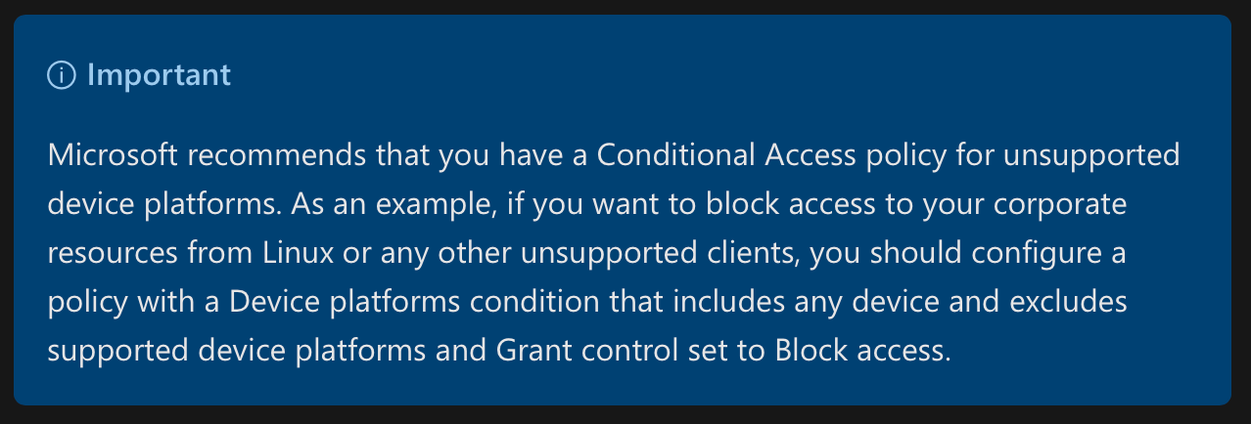
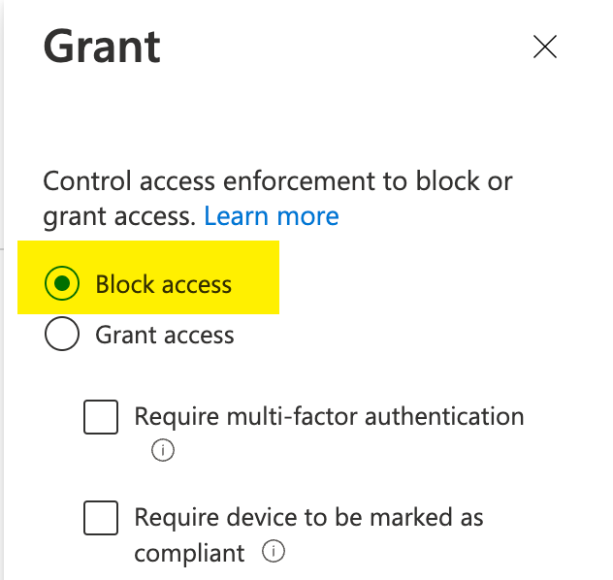
Linux as a device platform in Conditional Access
At least one policy that targets Any device, then exclude the platforms you DO support:
Current guidance is to have at least one policy that targets any platform, to catch OSes like Linux that can’t be targeted:

Slide 57
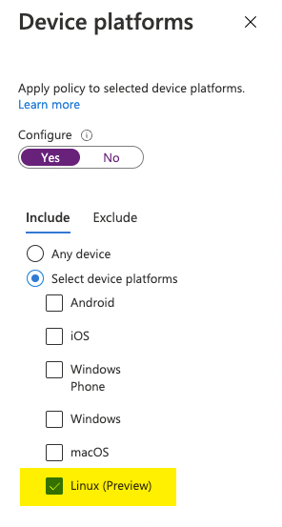
Linux as a device platform in Conditional Access
Device platform should be used in concert with Microsoft Intune device compliance policies for platforms that support Intune
Linux as a device platform can support a few core scenarios
Require MFA on Linux (typically while using other controls on other OSes)
Location-based policies specific to Linux
Risk-based policies specific to Linux
Sign in Frequency controls specific to Linux
Once Intune supports Linux, the Linux as a device platform control will be useful for targeting device-based policies at Linux as well...

Slide 58
Example Policy Set
When this happens: | Then do this:
An access attempt is made: - To a cloud app - By users and groups Using: - Condition 1: Device Platform is Windows, macOS, iOS, or Android | Grant access with (AND): - Requirement 1 (MFA) - Requirement 2 (Device Compliance)
An access attempt is made: - To a cloud app - By users and groups Using: - Condition 1: Device Platform is Linux | Grant access with (AND): - Requirement 1 (MFA) - Requirement 2 (Trusted Location)
An access attempt is made: - To a cloud app - By users and groups Using: - Condition 1: Any Device Platform OTHER than Windows, macOS, iOS, Android, or Linux | Block Access

Slide 59
Device registration type and Conditional Access
Supported registration type by OS – how each gets its PRT for SSO
Azure AD Join | Hybrid Azure AD Join | Azure AD Registered
Windows (WAM broker) | Windows (WAM broker) | Windows (WAM broker)
 |  | macOS (Intune CP broker)
 |  | iOS (Auth App broker)
 |  | Android (Intune CP broker)
 |  | *Linux* (Intune CP broker)
Supports device-based Conditional Access grant control by OS
Hybrid Azure AD Join | Compliant
Windows | Windows
 | macOS
 | iOS
 | Android
 | *Linux* (NEW)

Slide 60
Linux AAD and Intune Features
In Scope for Preview
Future Releases
Secure access to web applications (Azure, M365, SaaS, LOB, App Proxy, etc.) via Microsoft Edge browser for Linux
Enroll Ubuntu Desktop LTS (currently 20.04) in Intune and create AAD Registered device object
Create and enforce compliance policies
Support device compliance Conditional Access policies
Report on compliance status in MEM Portal
Compliance
Device Inventory
Enrollment success
Secure access to Azure resources via az cli
Secure access via git cli to Azure DevOps
Support additional distributions

Slide 61
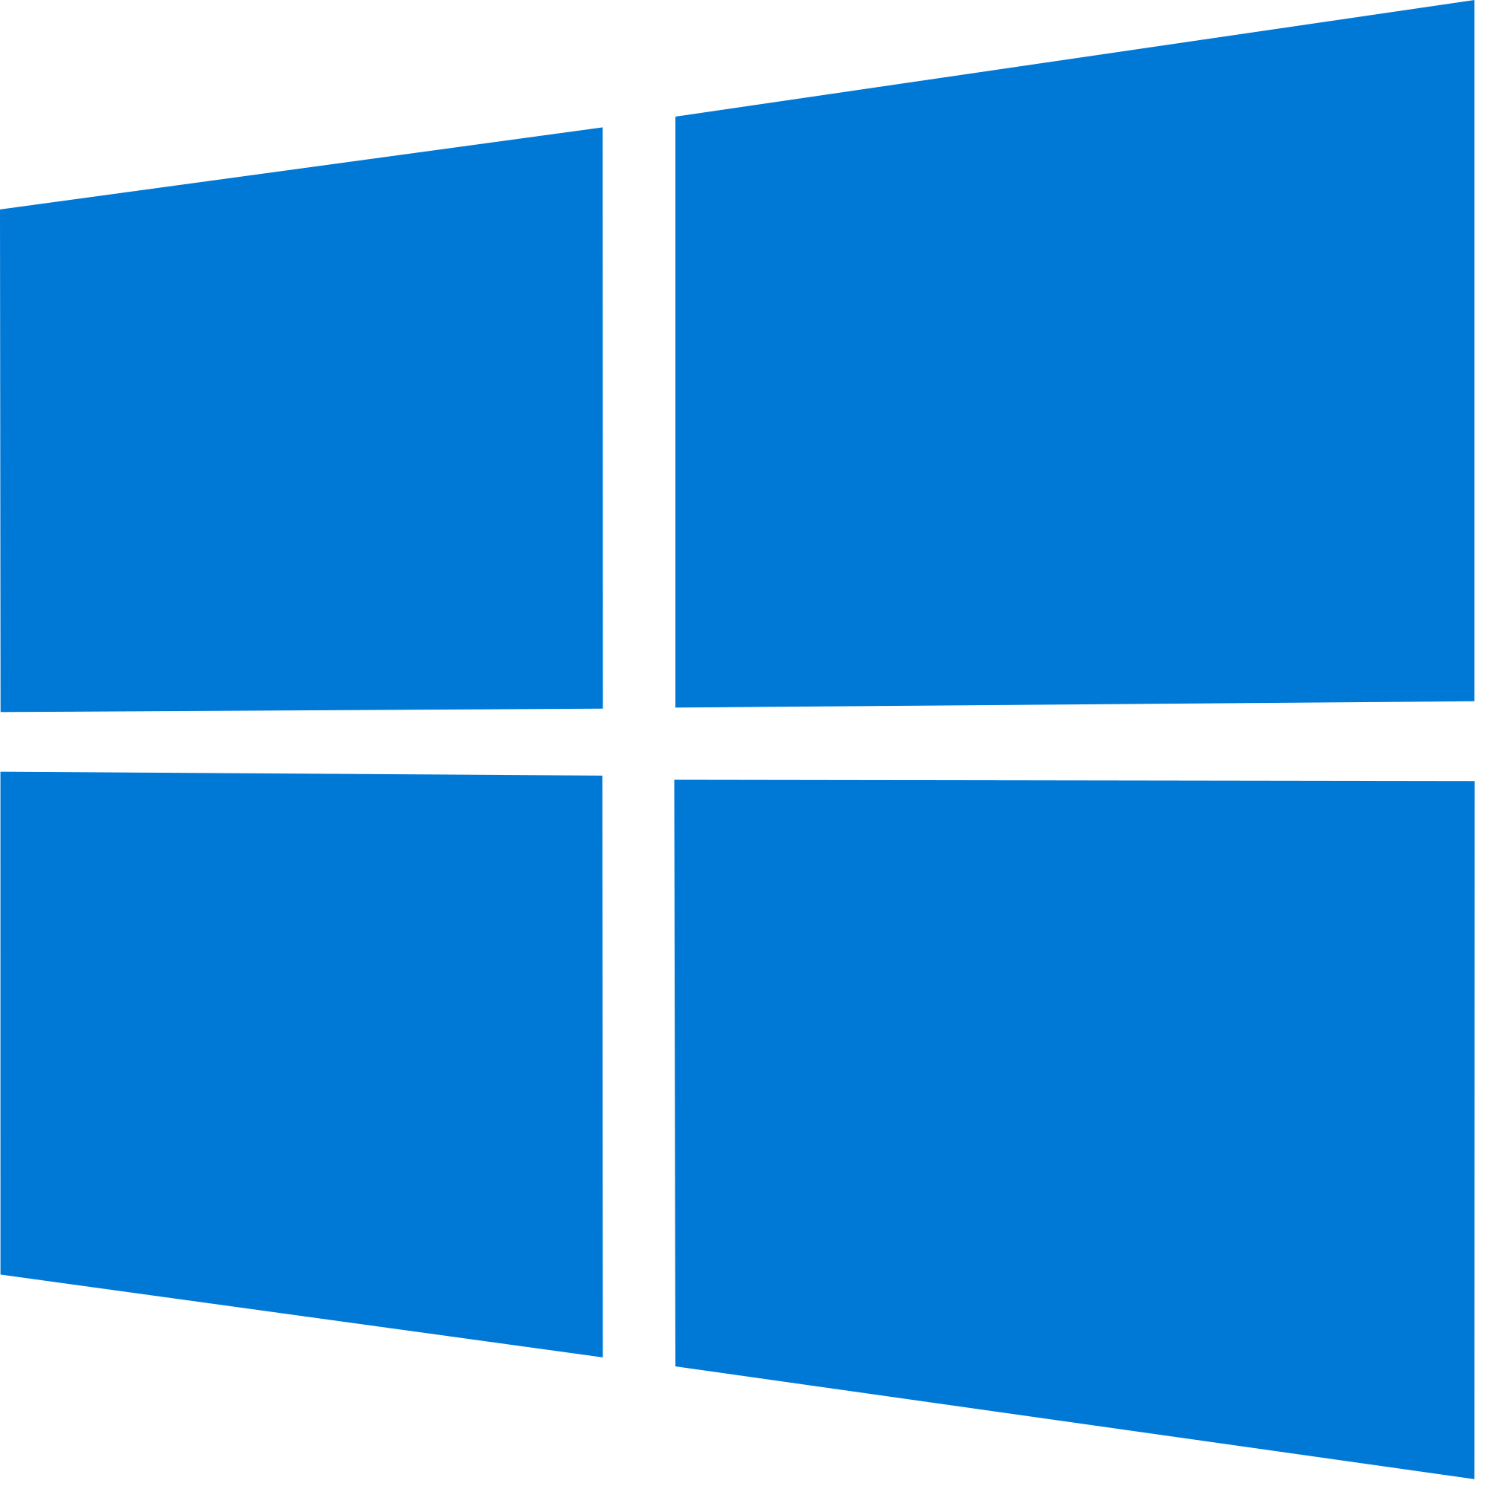
Registration
Linux Client
AAD Device
Registration
Azure AD
Intune Company Portal
Installed Together
Java Broker
MSAL
Intune
User initiates process by signing into
Intune Company Portal and beginning
enrollment

Slide 62
Registration
Linux Client
PRT and Device
Cert Returned
Azure AD
Intune Company Portal
Installed Together
Java Broker
MSAL
PRT
Intune Enrollment
Intune
User initiates process by signing into
Intune Company Portal and beginning
enrollment

Slide 63
Registration
Linux Client
Azure AD
Intune Company Portal
Installed Together
Java Broker
MSAL
PRT
Policy returned
Intune
User initiates process by signing into
Intune Company Portal and beginning
enrollment

Slide 64
Registration
Linux Client
Azure AD
Intune Company Portal
Installed Together
Compliance Information
Compliance Information
Java Broker
MSAL
PRT
Intune
User initiates process by signing into
Intune Company Portal and beginning
enrollment

Slide 65
Token Request
Conditional
Access
Evaluated
Linux Client
Token
Requested
Azure AD
Intune Company Portal
Installed Together
Compliance Information
Token
Returned
Java Broker
PRT
Compliance
Information
Intune
Apps
Edge
MSAL
Token Used
Token
Requested
Notes:
Check for cached token before going to AAD for new one
Hammer home that apps do not talk to the java broker, they go through MSAL

Slide 66
Recap & Go Dos!
Understand issues with prompting, talk to your IAM team
Modernize Linux server access, so they can be treated like any other resource subject to zero trust policies
Integrate your client OSes with the cloud to improve the user experience AND security:
MDM management for macOS via Intune or 3rd party MDM – use in Conditional Access
SSO for macOS via the Azure AD SSO Extension
Use Linux in CA policies now, device management later
Now: Linux as a device platform in CA
Later: MDM and SSO in Edge for Linux via the Intune Company Portal

Slide 67
Thank you
Slides: https://aka.ms/AADBTV2022

